Slide 1
DAPO: An Open Source LLM Reinforcement Learning System at Scale
Authors: Byte Dance Seed, Institute for AI Industry Research (Tsinghua University), SIA Lab (Tsinghua and ByteDance)

Slide 2
Outline
Background and Motivation
Introduction & Preliminaries
Method:
Clip Higher
Dynamic Sampling
Token Level Policy Gradients
Overlong Reward Shaping
Experiments and Results
Connection to RL for Reasoning Problems
Open-Sourced Dataset and Code built on the verl framework for those interested.

Slide 3
Background and Motivation
The Problem
As we have already seen in the past week or so:
RLHF has enabled us to get longer CoT and stronger reasoning.
While the theory is known to us, RLHF is also a lot of:
Algorithmic Tricks and Empirical Choices / Dataset Specific
Too many reward types (Verifiable, Non-Verifiable Real-World Rewards)
Many ways to stabilize training (Clip or not to clip?, How to sample in GRPO?, KL or no KL?)
However, for us here in academia, this is mostly based on what we read. The super smart folks at OpenAI [1] and even DeepSeek [2] have mostly hidden methods that are essential for fixing issues like:
Entropy Collapse (Mostly seen in GRPO)
Reward Noise
Training Instability
[1] OpenAI. Learning to reason with llms, 2024 [2] Guo et al. Deepseek-r1: Incentivizing reasoning capability in llms via reinforcement learning

Slide 4
Background and Motivation
What did the authors do?
They started off by taking taking DeepSeek R1 paper (whatever they did report) and trying to replicate similar results by using GRPO on Qwen2.5-32B.
Results? 30 Points on AIME. DeepSeek claimed 47 on the same benchmark! Similar points noted by [3] and [4].
What do they propose?
Open-Source Large-Scale RLHF framework with techniques they found (some based in theory, some that I find mostly empirical) to help with Long-CoT reasoning in LLMs.
Claim that their method, Decoupled Clip and Dynamic sAmpling Policy Optimization (DAPO), achieves 50 points on AIME 2024 (+3) with 50% of training steps used in DeepSeek-R1-Zero-Qwen-32B.
[3] Chen et al. An empirical study on eliciting and improving r1-like reasoning models [4] Yuan et al. What’s behind ppo’s collapse in long-cot? Value Optimization holds the secret

Slide 5
Introduction
They propose 4 key techniques:
CLIP HIGHER - Remember Clipping? They propose increasing the upper limit of the clip.
DYNAMIC SAMPLING - GRPO is only effective if each group has some outputs with an advantage. How to ensure that?
TOKEN-LEVEL Policy Gradient - Super key for Long-CoT. Longer responses should have more influence on overall gradient update
REWARD SHAPING - Soft Punishment for longer responses.
And 2 minor one’s:
PPO had the KL term. DPO made it implicit. GRPO had it implicitly, but still kept it. They remove it.
Super simple verifiable reward function. Just basically a binary reward function.

Slide 6
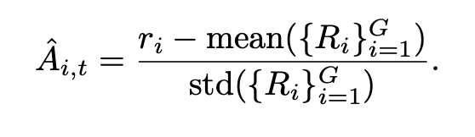
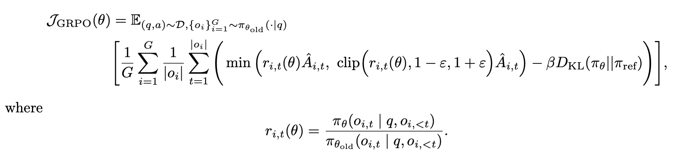
Preliminaries and Minor Changes
GRPO (Group Relative Policy Optimization)
How is it different from PPO? No Value Function. Advantage is estimated based on groups. Advantage of i-th response is:
Similar to PPO in the sense that it still has the clipped objective and KL Penalty.
Sample Level Objective. Mean Loss within generated sequence then averaged for all samples.

Slide 7
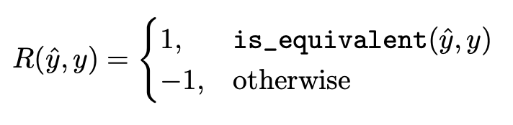
Preliminaries and Minor Changes
Why? Long-CoT specifically requires model to diverge from initial model. Necessary to support longer reasoning.
DAPO (Decouple Clip and Dynamic Sampling Policy Optimization)
How is it different from GRPO? No KL Term.
They also change the reward model. Justification given is that it prevent Reward Hacking. Verifiable Reward based only on the outcome (There is also another reward component which comes later).

Slide 8
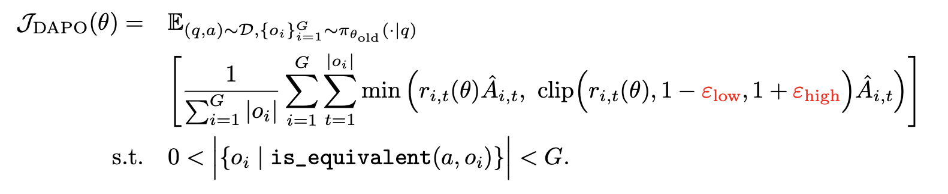
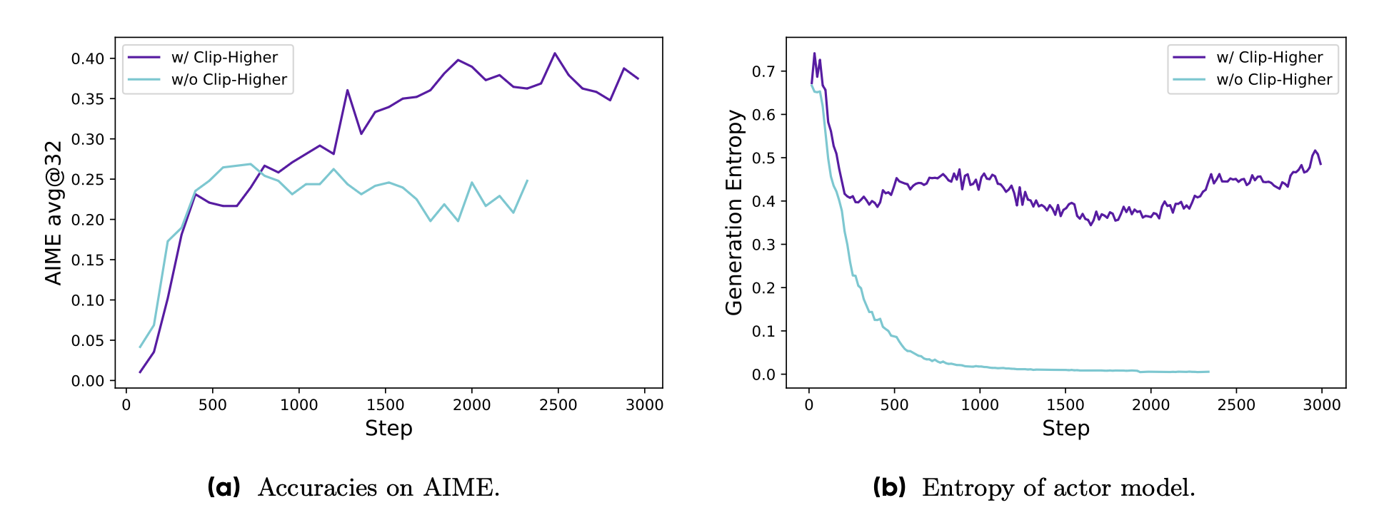
Method: Clip Higher
Why is it needed?
PPO and GRPO suffer from entropy collapse - Entropy of policy decreases quickly with training. Sampled responses are identical! In RL, this is exploration vs exploitation case. Entropy Collapse causes low exploration and deterministic policy (Cause issues with scaling)!
The authors propose that this is because the upper clipping restricts exploration.
Decoupled because E_high and E_low are different - fancy naming.
In practice, I just think this is an empirical choice. They take E_High as 0.28 instead of the default 0.2 and keep E_Low as 0.2, the default.

Slide 9
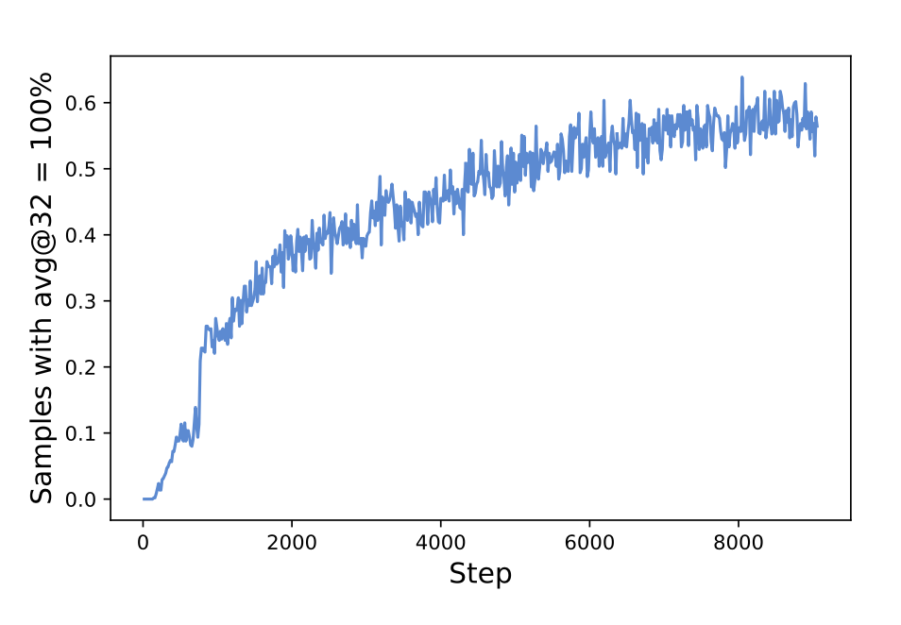
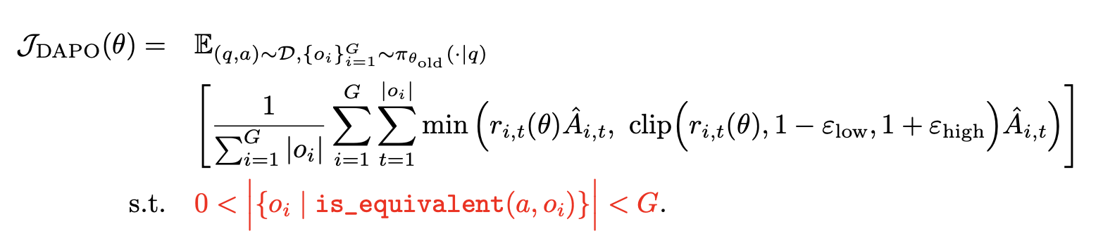
Method: Dynamic Sampling
Why is it needed?
Gradient-Decreasing problem. Its normal for some prompt responses in the RLHF training process to have an accuracy of 1. But in GRPO, if all outputs of a group have accuracy 1, the resulting advantage is 0! Hence, no gradients and reduced efficiency.
The authors propose over-sample and then filter responses with accuracy as 1 or 0.
I do think this is also because of the overly simple reward function. Soft rewards not just based on the outputs may help with this?

Slide 10
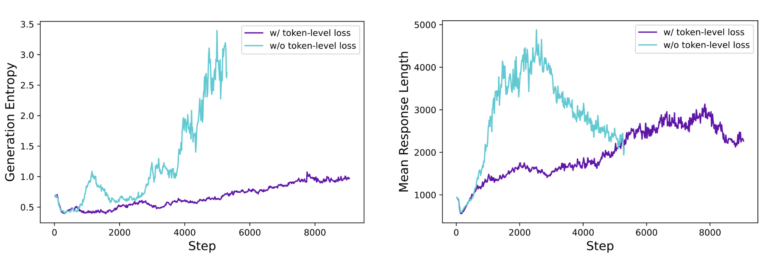
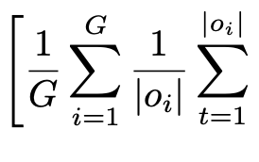
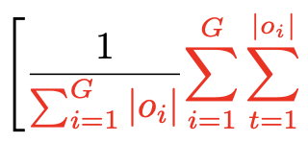
Method: Token-Level Policy Gradient Loss
Why is it needed?
Original GRPO algorithm uses sample-level loss calculation. Average the losses by token within sample -> Aggregate losses across all samples. Issues?
Each sample has equal contribution.
If a response is overly long, it still has same loss contribution. Good long responses don’t get any benefit and bad long responses don’t get punished enough. Isn’t optimized for Long-CoT!
Gives smoother entropy and response length increase.

Slide 11
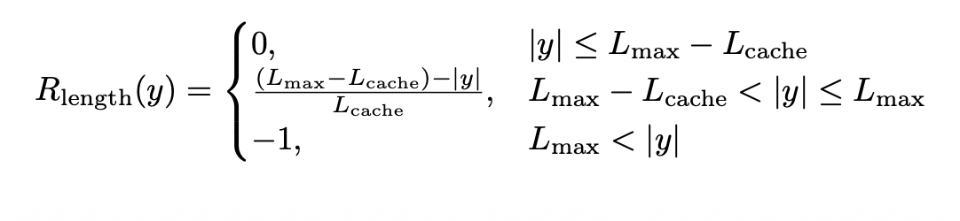
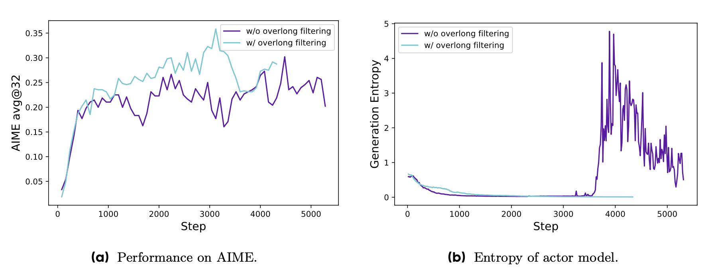
Method: Overlong Reward Shaping
Why is it needed?
Typical Rl training has fixed maximum length for generation - Long samples truncated. Authors say that is counter-intuitive for Long-CoT + Introduces noise.
Solution they tried was two fold:
Overlong Filtering - Mask the loss of truncated samples - no confusion in training process.
Soft overlong punishment - Length-aware penalty for truncated samples. Longer the response, greater the punishment.
Note the interval. In that interval, longer the response, greater the punishment. It is dependent on actual answer’s length.

Slide 12
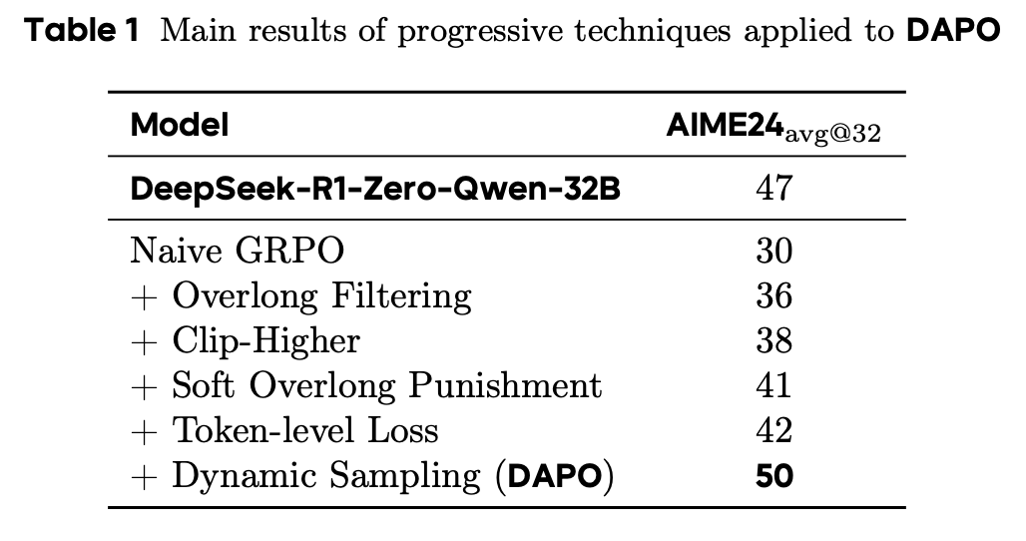
Experiments and Results
Experimental Setup
Dataset - Sourced from Art of Problem Solving Website - Manual Annotation. Answers transformed to integers (Makes reward modeling simpler and matches AIME format). Open-sourced DAPO-MATH-17k dataset.
Training Setup
AdamW with LR of 1e-6. Linear warm-up over 20 rollouts.
Prompt batch size is set to 512 and 16 responses sampled for each prompt.
Max tokens is set to 16,384 (Expected) and L_cache of 4096 for soft punishment.
Clip High of 0.28 and Clip Low of 0.2. Results are avg@32.
Temperature 1.0 and top-p of 0.7.
Dynamic Sampling technically needs more samples than naive GRPO -> However, in general you need fewer steps to converge so it's fine.
Note how token-level loss doesn’t actually do much -> Authors say it stabilizes training though (?)

Slide 13
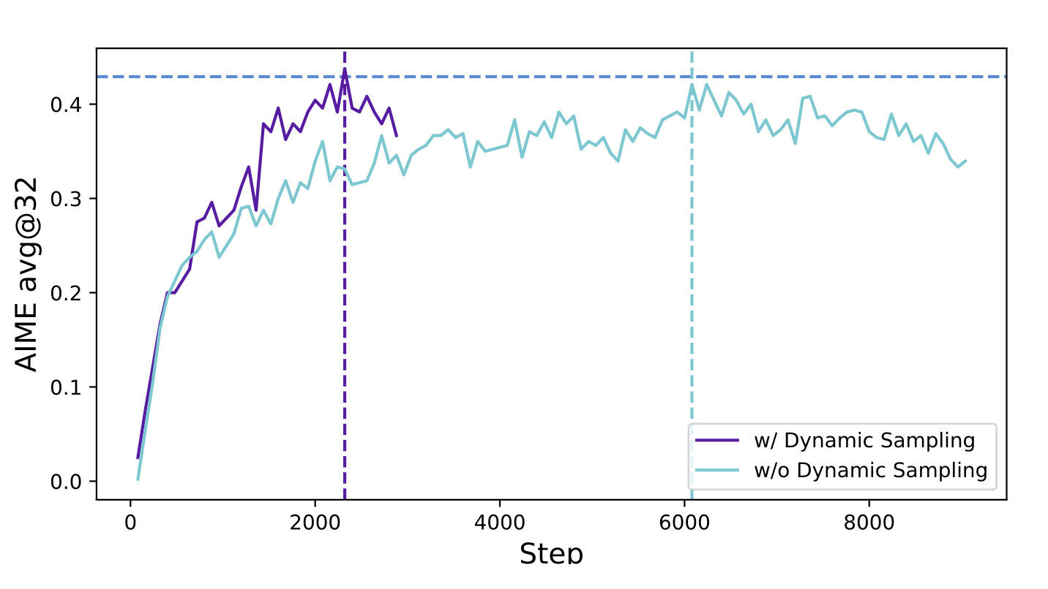
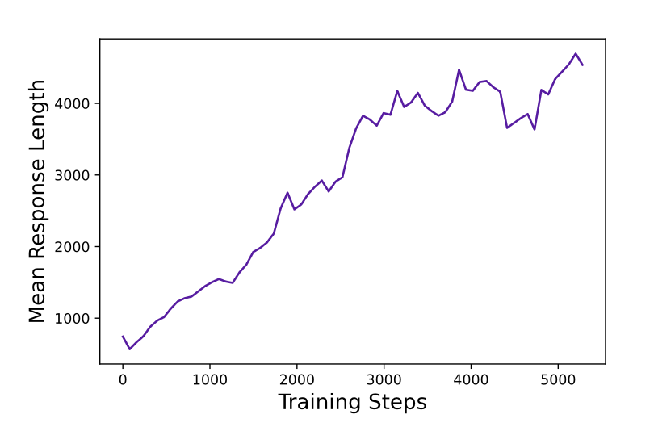
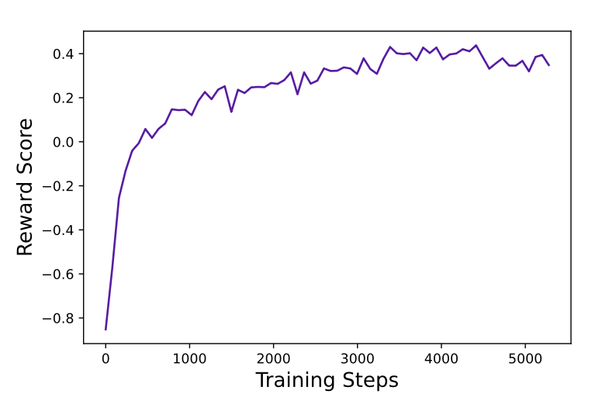
Conclusions
Surprisingly faster convergence. Would have been nice to see this plot for each of the ablations.
Very stable reward increase. No fluctuation shows stable training.
Elicits Long-Reasoning with more training steps. Note that correlation with accuracy shows this isn’t gibberish just for the sake of being long.

Slide 14
Questions?
(and the next paper)

Slide 15
Understanding R1-Zero-Like Training: A Critical Perspective
Authors: Zichen Liu, Changyu Chen, Wenjun Li, Penghui Qi, Tianyu Pang, Chao Du, Wee Sun Lee, Min Lin
* When (and why) RL is effective for reasoning problem?
Notes:
The paper we will be discussing today is <title>. Pretty recent paper from Google/MILA Quebec.

Slide 16
Outline
Background & Motivation
Introduction & Goals
Analysis on Base Models
Role of Templates for Base Models to Function as a Question-Answering Base Policy
Qwen-2.5 Models Unlock the Best Performance When Discarding Template
Self-Reflection Already Appears in Base Models Including DeepSeek-V3-Base
Analysis on Reinforcement Learning
GRPO Leads to Biased Optimization
Dr. GRPO: Group Relative Policy Optimization Done Right
How Different Templates Affect the RL Training
Domain-Specific Pretraining Improves RL Ceiling
Conclusions
Notes:
Give outline! Mention Reversible Transformer!

Slide 17
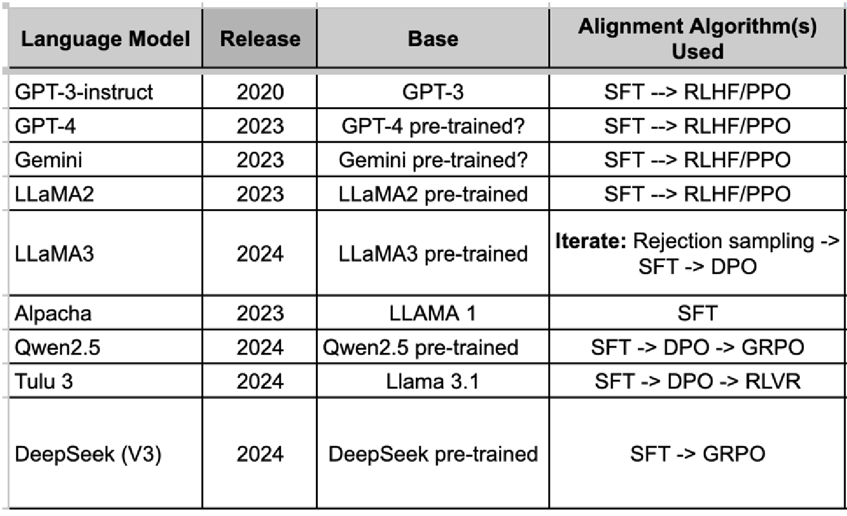
Background & Motivation
What’s common?

Slide 18
Background & Motivation
How DeepSeek-R1-Zero [1] differs and what they claim:
Drop SFT, directly apply RL to base LLMs with simple rule-based or reward rules
No need for massive human-labeled data (QnA pairs, CoT examples etc.)
Avoid domain bottleneck and single-path bias
Use synthetic rules as reward functions (e.g., correctness checker for math, compiler for code)
The whole pipeline reduces to: base model → RL with cheap reward signals
Allows the model to explore chain-of-thought (CoT) for solving complex problems – How?
No imitation from dataset; sample many candidate answers → verify using reward functions and REINFORCE!
Reward models/general rules generalize better than fixed labels
“Emergent behaviors” like self-reflection (“aha moment”), self-verification, longer CoT, etc., emerge during RL
[1] Deepseek-r1: Incentivizing reasoning capability in llms via reinforcement learning. arXiv preprint arXiv:2501.12948, 2025.

Slide 19
Background & Motivation
BUT, there were many open questions:
How much of the reasoning was already present in the base model? Maybe the model was already good, and RL just polished it or revealed preexisting capacities?
What exactly in the RL algorithm contributes to improvements? Reward rules, the template over prompts, structure of question sets?
Are there optimization artifacts or biases that make things look better than they are? (E.g. being rewarded for longer answers rather than correctness, etc.?)
How much compute / how much “RL effort” is actually required; can simpler or “minimalist” versions can reach comparable performance?
[1] Deepseek-r1: Incentivizing reasoning capability in llms via reinforcement learning. arXiv preprint arXiv:2501.12948, 2025.

Slide 20
Introduction & Goals
At high level, the paper has three goals:
Dissect the R1-Zero paradigm into its two main components
For each component, examine how much of the “reasoning ability” that R1-Zero claims comes
For free from the pre-training
Actually from the RL procedure
By asking these two questions:
Do base models already show emergent reasoning / “aha moments,” self-reflection, etc., without RL?
Do certain model families (e.g. Qwen2.5, DeepSeek-V3-Base) have pretraining biases (e.g. training data, template usage) that make them more “ready” for R1-Zero style training?
Base Model
RL training dynamics
ada
asdasd
Identify “hidden” biases or artifacts in the RL method used in R1-Zero (specifically GRPO). They may:
Inflate performance or
Inflate reasoning metrics in misleading ways

Slide 21
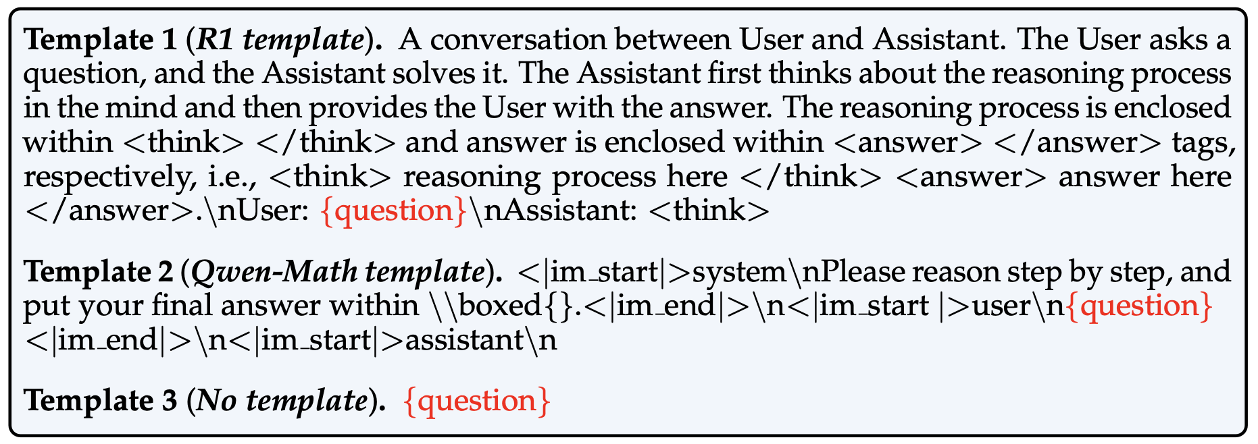
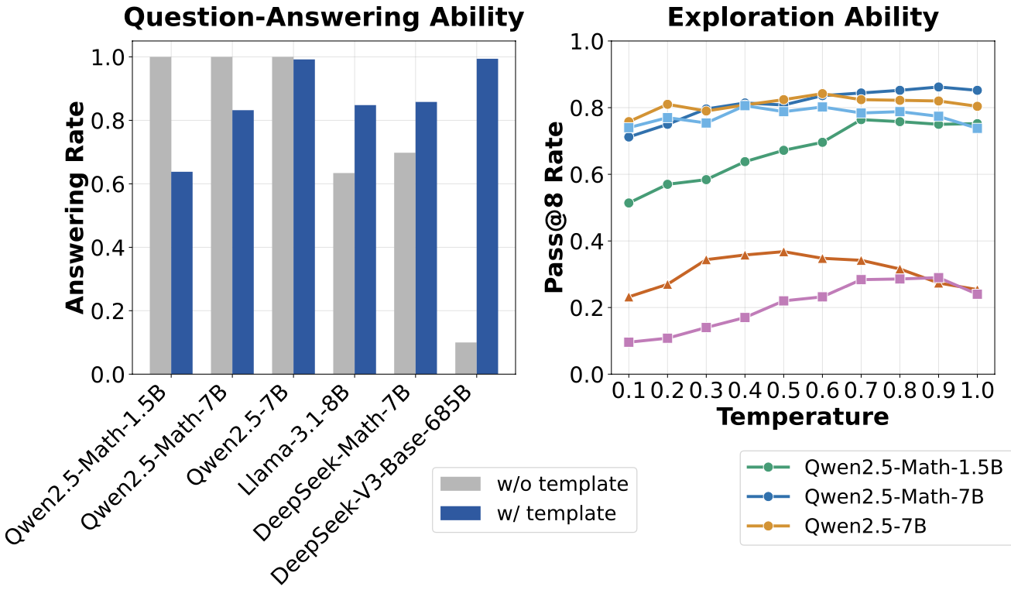
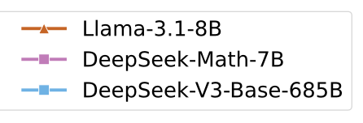
Analysis on Base Models - Take 1
Open-source base models → typically trained for sentence completion (p_{θ}(x)), not Q&A
To make them usable for R1-Zero, templates act like a “bridge”: they turn the model into a question-answering policy π_{θ}(⋅∣q)
Core Question: Can the base models function as a question-answering base policy, given appropriate templates?
500 questions sampled from the MATH [2] training set
Asked GPT-4o-mini to judge whether the model responses are in an answering format
[2] Measuring mathematical problem solving with the math dataset. arXiv preprint arXiv:2103.03874, 2021.
Notes:
ssdfsd sfsfds

Slide 22
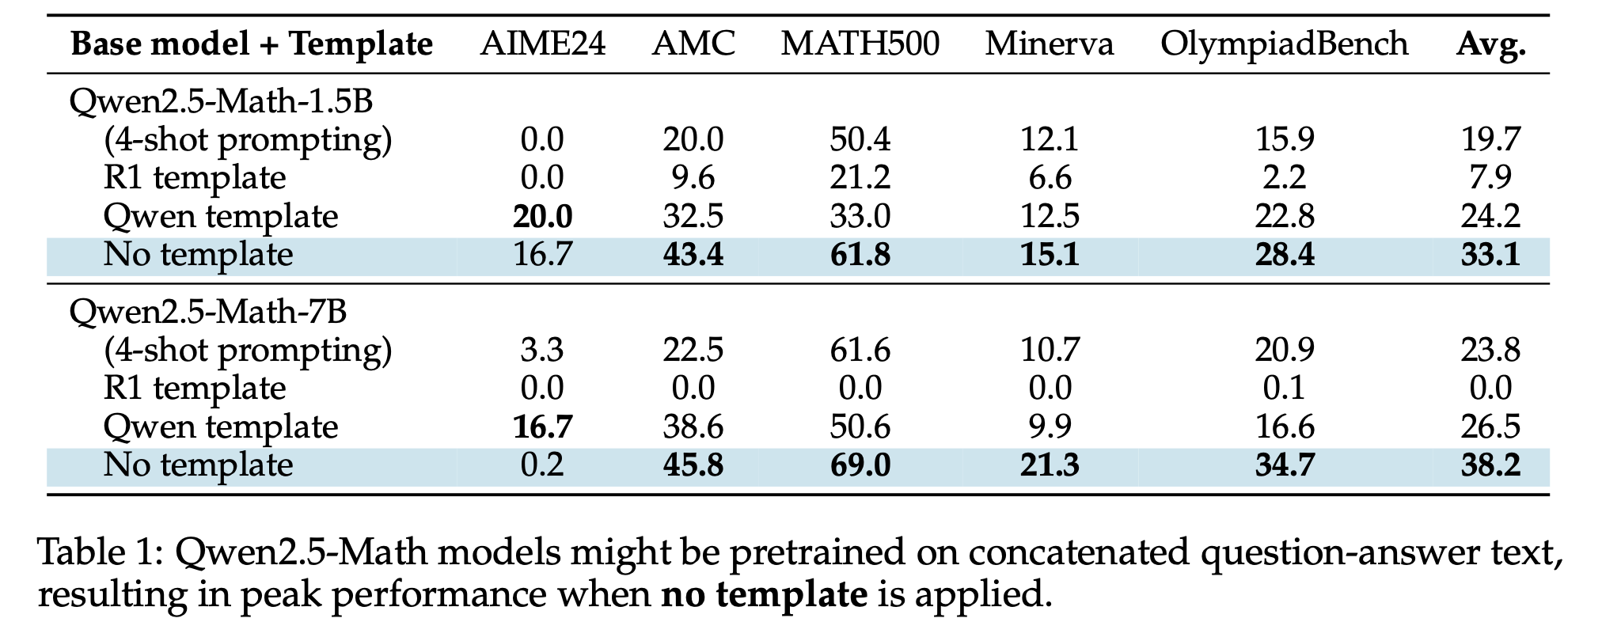
Analysis on Base Models - Take 2
Observation: Qwen2.5 models work best when no template is used → warrants further investigation
Goal: Evaluate the reasoning ability on five standard benchmarks
Not using any template → improvement of about 60% compared to 4-shot prompting
Hypothesis based on the result:
Qwen2.5-Math had chat-style question-answer pairs in its pretraining data
They might have pretrained on the concatenated text to maximize log p_{θ}(q; o) directly
The base models are already SFT-like without templates
Notes:
ssdfsd sfsfds

Slide 23
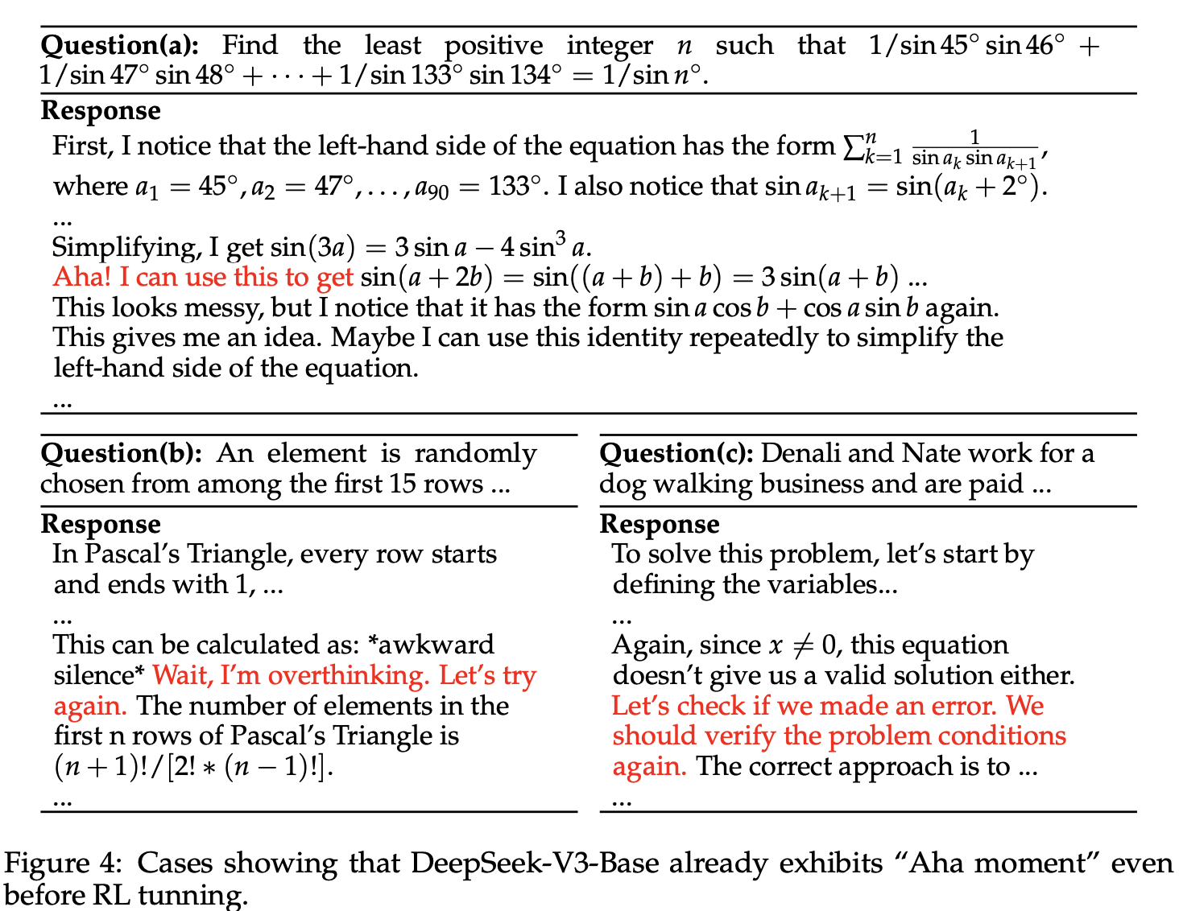
Analysis on Base Models - Take 3
Observation: Lowest answering rate with no template suggests that DeepSeek-V3-Base is a nearly pure base model
Question: Does a pure base model like DeepSeek-V3-Base demonstrate self-reflection?
Important follow-up: Does self-reflection actually make answers more accurate?
Experiments:
Pick questions where the model sometimes reflects on itself
For each such question, sample 100 answers
Split them into two groups: w/ and w/o self-reflection
Measure accuracy separately for both groups
Compare accuracy difference between the two
Finding: In about half the cases, the self-reflective answers were not more accurate than the non-reflective ones.
Notes:
ssdfsd sfsfds

Slide 24
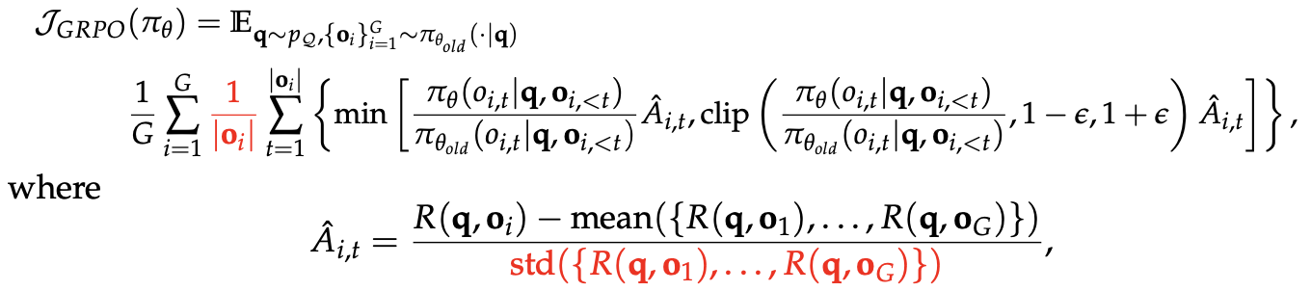
Analysis on RL - Length Bias in GRPO
Response-level length bias: This arises from dividing by |o_{i}|. How?
Case 1: Positive advantage (A_{i, j} > 0) -
Short correct answer contributes more per token to the gradient than longer correct answers
Result: model “learns” that if it wants to be rewarded strongly for being correct, it should output short answers
Case 2: Negative advantage (A_{i, j} < 0) -
Longer wrong answers gets less penalty per token than shorter wrong answers
Result: the model “learns” that if it’s going to be wrong, it’s safer (less penalized) to output longer responses

Slide 25
Analysis on RL - Difficulty Bias in GRPO
Question-level difficulty bias: This arises from dividing by the standard deviation. How?
Case 1: std is small (everyone got similar reward), the advantage becomes large, question gets upweighted
Case 2: std is large (mixed correct/wrong answers), the advantage shrinks, question gets downweighted
Consequences:
Too easy questions (everyone correct, std ≈ 0)→upweighted (Model wastes effort reinforcing trivial questions)
Too hard questions (everyone wrong, std ≈ 0)→also upweighted (Model spends lots of gradient on questions where it has no signal (since all answers are wrong)
Medium-difficulty questions (some right, some wrong, std high) → downweighted (These are actually the most useful questions (good learning signal), but GRPO gives them less weight!)
Model’s learning dynamics are biased towards very easy or very hard questions

Slide 26
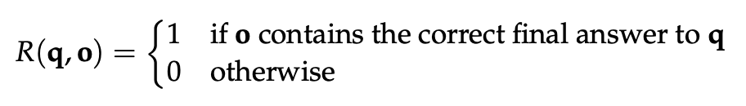
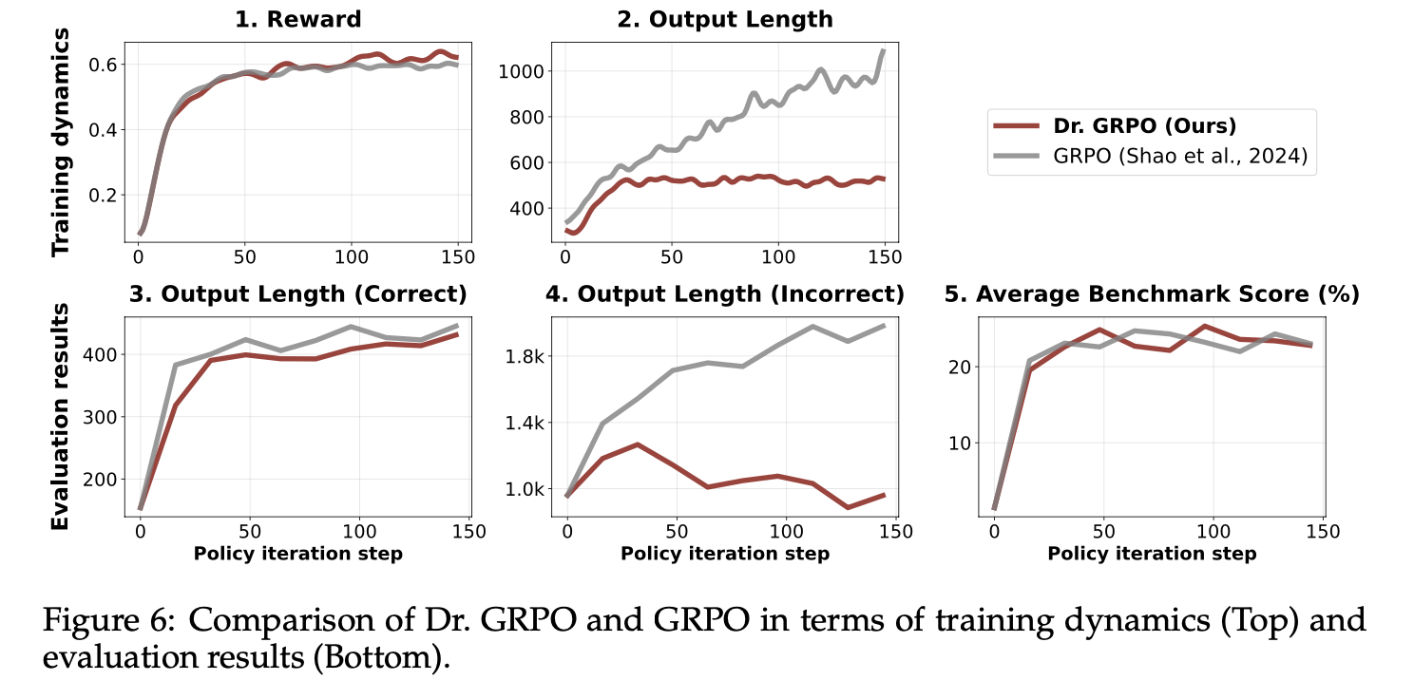
Dr. GRPO: GRPO Done Right
Simply drop the normalization terms
Experiments on Qwen2.5-1.5B and R1 template with the following reward function:
Both exhibit similar trends for reward
GRPO → Tends to continually generate longer responses even when the reward improvement slows down
The length of incorrect responses is substantially reduced by Dr. GRPO compared to the baseline (Plot 4).
This suggests that that an unbiased optimizer also mitigates overthinking.

Slide 27
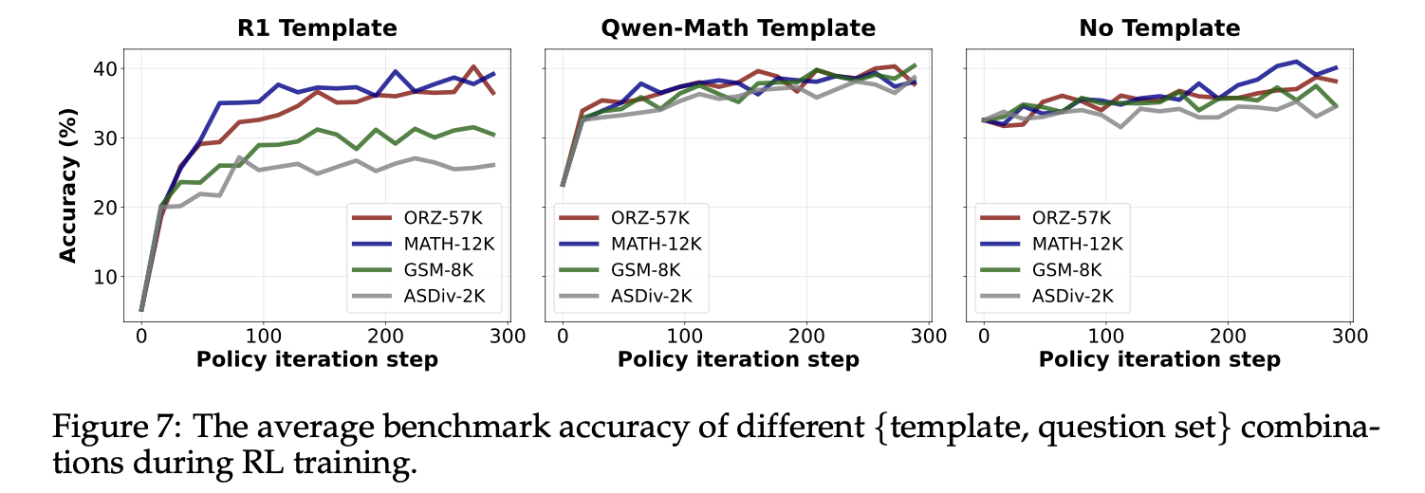
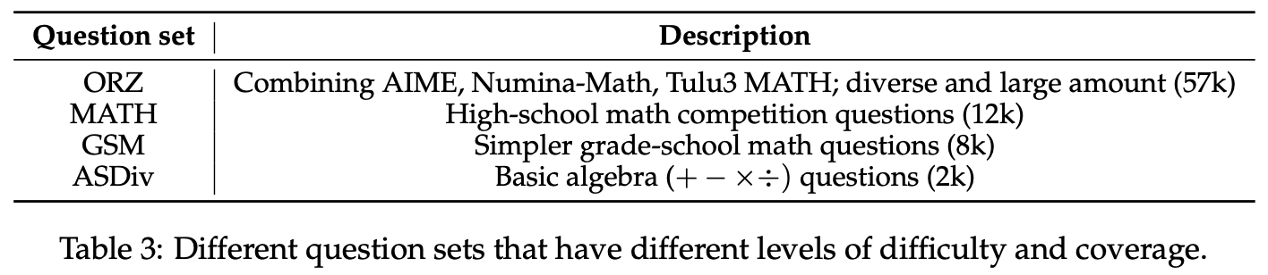
How Different Templates Affect RL Training
Motivation 1: Qwen2.5-Math base models can answer questions with high accuracy without any prompt template
Motivation 2: General belief: larger question set coverage leads to better performance - experiment with different templates and different levels of question coverage
RL can improve all policies to a comparable performance
R1 template - question sets have a significant impact on the dynamics of RL (lower coverage = lower performance)
Applying templates in fact destructs the capability before RL reconstructing it
Large mismatch between base models and templates → policy improvement mainly comes from RL- tuning
Else → even a small and completely o.o.d. question set could induce the reasoning ability equally well, by reinforcing correct reasoning behaviors instead of infusing new knowledge

Slide 28
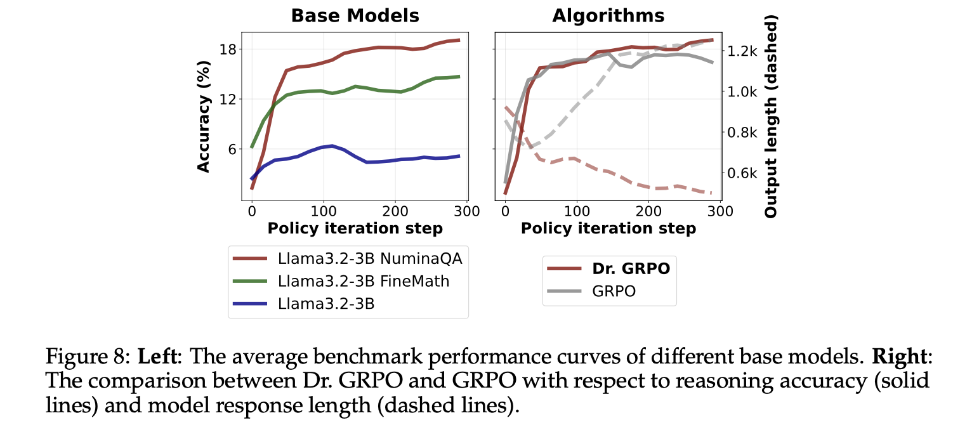
Can R1-Zero-like Training Succeed on Originally Weak Base-Models?
Motivation: Recent R1-Zero-like replications mostly employ Qwen2.5 base models as the initial policies
They are already strong math solvers and exhibit self-reflection patterns, as we’ve seen
What about originally weak base models?
What about domain-specific pretraining?
Experiments on Llama-3.2-3B with Dr. GRPO and R1 template
Llama-3.2-3B-FineMath - continual pretrained on the FineMath dataset
To keep consistency with Qwen2.5 models, also prepare a concatenated dataset from NuminaMath-1.5 and continual pretrain it
RL works best when the base already has domain knowledge + Q&A knowledge
RL helps, but only a little on Vanilla LLaMA
GRPO → Both accuracy ↑ and length ↑ → → misleading ‘emergence’ of longer CoT
Dr. GRPO → Accuracy ↑, length ↑
Accuracy ↓, length ↓ → true improvement

Slide 29
Conclusions
So, when (and why) RL is effective for reasoning problem (this paper’s context)?
✅ RL is effective when the base model already has latent reasoning or domain knowledge
E.g., Qwen2.5 pretraining → strong math skills + QA bias; LLaMA needs math pretraining to reach a usable ceiling
✅ RL reinforces and polishes existing reasoning behaviors, it does not create them from scratch
Templates + base alignment matter: if mismatched, RL must work harder and needs broad coverage datasets
✅ RL must be optimized without bias
GRPO can fake progress by rewarding length; Dr. GRPO corrects this, yielding true improvements
✅ Minimalist recipe works
With the right base model + Dr. GRPO, even modest compute can reach SOTA on reasoning benchmarks

Slide 30
Questions?

